Slide 1
Introduction to Functions
ELEC1006: ENGINEERING COMPUTING

Slide 2

Modular Programming & Functions
Modular programming: Break a program up into smaller, manageable functions or modules.
Function: A collection of statements to perform a task.
Motivation for modular programming:
Improves maintainability of programs.
Simplifies the process of writing programs.
PAGE 2

Slide 3
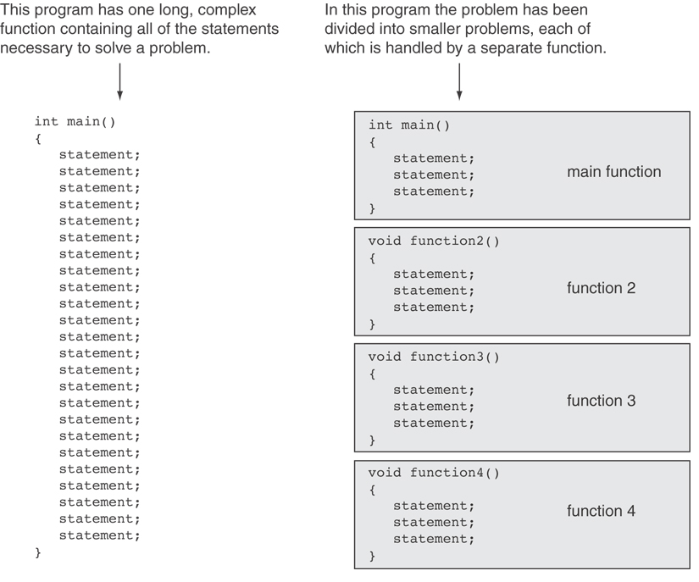
PAGE 3

Slide 4
Defining & Calling Functions
Function call: A statement that causes a function to execute.
Function definition: Statements that make up a function.
PAGE 4

Slide 5
Function Definition
Definition includes:
Name: Function names follow same rules as variables.
Parameter list: Variables containing values passed to the function.
Body: Statements that perform the function’s task, enclosed in {}.
Return type: Data type of the value that function returns to the part of the program that called it.
PAGE 5

Slide 6
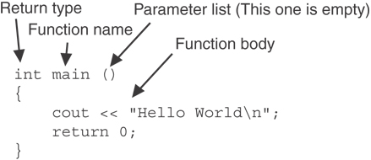
main() Function
Note: The line that reads int main() is the function header.
PAGE 6

Slide 7
Function Return Type
If a function returns a value, the type of the value must be indicated:
int main()
{
cout << “Hello World!\n";
return 0;
}
If a function does not return a value, its return type is void:
void main()
{
cout << “Hello World!\n";
}
PAGE 7

Slide 8
More info
[1] cplusplus.com: Functions
https://cplusplus.com/doc/tutorial/functions/
[2] learncpp.com: 2.1 – Introduction to Functions
https://www.learncpp.com/cpp-tutorial/introduction-to- functions/
PAGE 8

Slide 9
Calling a Function
ELEC1006: ENGINEERING COMPUTING

Slide 10
Calling a Function
To call a function, use the function name followed by () and ;
printHeading();
When a function is called, a program executes the body of the called function.
After the function terminates, execution resumes in the calling function at the point of call.
PAGE 10

Slide 11
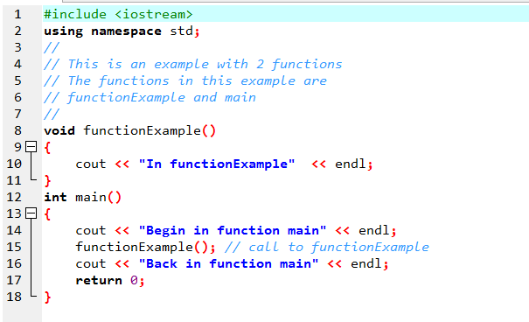
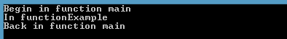
Example
PAGE 11

Slide 12
Flow Control in Example
PAGE 12

Slide 13
Calling Functions
main can call any number of functions.
Functions can call other functions.
int main()
{
func1(); // Call func1()
}
void func1()
{
func2(); // Call func2()
}
PAGE 13

Slide 14
More info
[1] cplusplus.com: Functions
https://cplusplus.com/doc/tutorial/functions/
[2] learncpp.com: 2.1 – Introduction to Functions
https://www.learncpp.com/cpp-tutorial/introduction-to- functions/
PAGE 14

Slide 15
Function Prototypes
ELEC1006: ENGINEERING COMPUTING

Slide 16
Defining a Function
A function is defined first before the main() function.
Starting from the top, a compiler detects that functionExample is declared as a function and so the code below compiles successfully.
#include <iostream>
using namespace std;
void functionExample()
{
cout << “In functionExample() function”;
}
int main()
{
functionExample(); // Call function
return 0; // Exit program
}
PAGE 16

Slide 17
Changing the Order
Changing the order of the function below so that main() is declared before functionExample() yields an error in compilation.
#include <iostream>
using namespace std;
int main()
{
functionExample(); // Call function
return 0; // Exit program
}
void functionExample()
{
cout << “In functionExample() function”;
}
PAGE 17

Slide 18
Function Prototypes
Ways to notify the compiler about a function before a call to the function:
Place function definition before calling function’s definition
Use a function prototype (function declaration) – like the function definition without the body
Prototype: void functionExample();
Header: void functionExample() { statements }
PAGE 18

Slide 19
Prototype Notes
Place prototypes near top of program.
Program must include either prototype or full function definition before any call to the function – otherwise there is compiler error.
When using prototypes, can place function definitions in any order in source file.
PAGE 19

Slide 20
Example
#include <iostream>
using namespace std;
void functionExample(); // Function prototype
int main()
{
functionExample(); // Call function
return 0; // Exit program
}
void functionExample()
{
cout << “In functionExample() function”;
}
PAGE 20

Slide 21
More info
[1] cplusplus.com: Functions
https://cplusplus.com/doc/tutorial/functions/
[2] learncpp.com: 2.7 – Forward declarations and definitions
https://www.learncpp.com/cpp-tutorial/forward- declarations/
PAGE 21

Slide 22
Sending Data into a Function
ELEC1006: ENGINEERING COMPUTING

Slide 23
Sending Data into a Function
Values can be passed into a function at time of call:
c = pow(a, b);
(Note: This function needs #include <cmath> to work)
Values passed into a function are arguments.
Variables in a function that hold the values passed as arguments are parameters.
PAGE 23

Slide 24
A Function with a Parameter Variable
void displayValue(int num)
{
cout << "The value is " << num << endl;
}
The integer variable num is a parameter. It accepts any integer value passed to the function.
PAGE 24

Slide 25
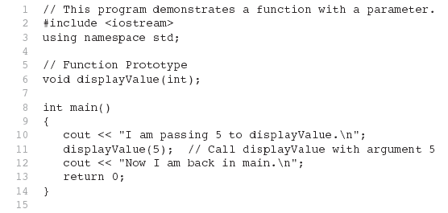
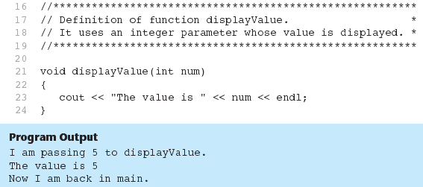
Only data type
Full declaration
PAGE 25

Slide 26
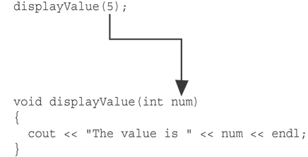
argument
The function call in line 11 passes the value 5
as an argument to the function.
PAGE 26

Slide 27
Passing Multiple Arguments
When calling a function and passing multiple arguments:
the number of arguments in the call must match the prototype and definition
the first argument will be used to initialize the first parameter, the second argument to initialize the second parameter, etc.
PAGE 27

Slide 28
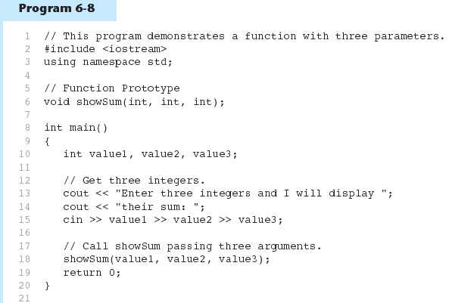
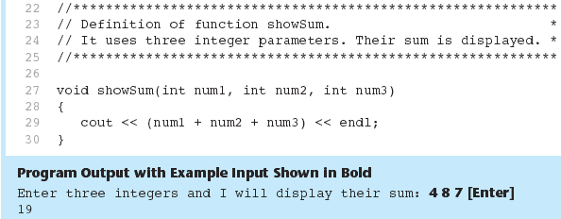
Only data type
Full declaration
PAGE 28

Slide 29
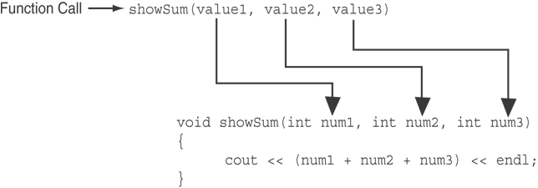
The function call in line 18 passes value1,
value2, and value3 as a arguments to the
function.
PAGE 29

Slide 30
Passing Data by Value
Pass by value: when an argument is passed to a function, its value is copied into the parameter.
Changes to the parameter in the function do not affect the value of the argument.
Example: int val=5;
evenOrOdd(val);
evenOrOdd can change variable num, but it will have no effect on variable val.
val
num
5
5
argument in
calling function
parameter in
evenOrOdd function
PAGE 30

Slide 31
More info
[1] cplusplus.com: Functions
https://cplusplus.com/doc/tutorial/functions/
[2] learncpp.com: 2.3 – Introduction to function parameters and arguments
https://www.learncpp.com/cpp-tutorial/introduction-to- function-parameters-and-arguments/
PAGE 31

Slide 32
Return a Value from a Function
ELEC1006: ENGINEERING COMPUTING

Slide 33
The return Statement
Used to end execution of a function.
Can be placed anywhere in a function.
Can be used to prevent abnormal termination of program (see Example 2).
In a void function, where there is no return statement, the function ends at its last }.
PAGE 33

Slide 34
1) Returning a Value from a Function
In a value-returning function, the return statement can be used to return a value from function to the point of call. Example:
int sum(int num1, int num2) { double result; result = num1 + num2; return result; }
Return Type
Value Being Returned
PAGE 34

Slide 35
2) Returning a Value from a Function
int sum(int num1, int num2) { return num1 + num2; }
Functions can return the values of expressions, such as num1 + num2
PAGE 35

Slide 36
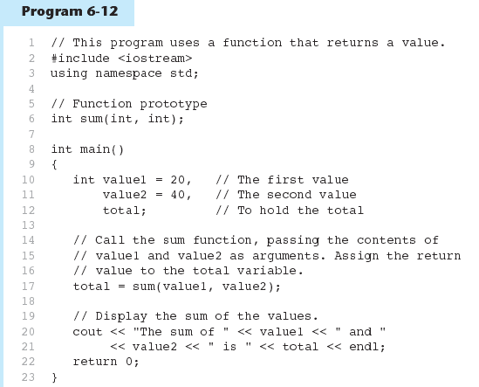
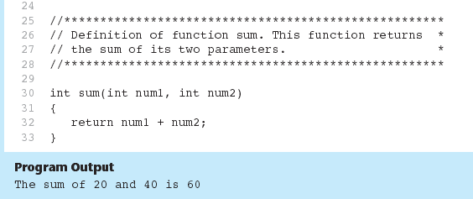
Example 1
PAGE 36

Slide 37
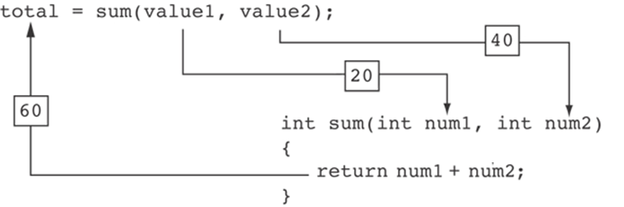
Example 1 continued …
The statement in line 17 calls the sum function, passing value1 and value2 as arguments. The return value is assigned to the total variable.
PAGE 37

Slide 38
3) Returning a Value from a Function
The prototype and the definition must indicate the data type of return value (not void).
Calling function should use return value:
assign it to a variable.
send it to cout.
use it in an expression.
Statements that follow the return statement will not be executed. See Example 2.
PAGE 38

Slide 39
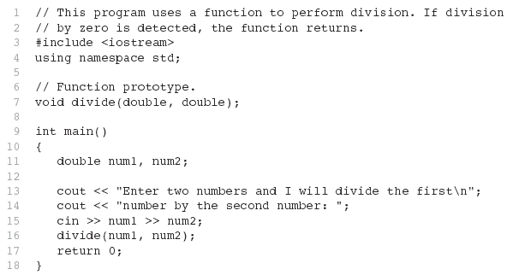
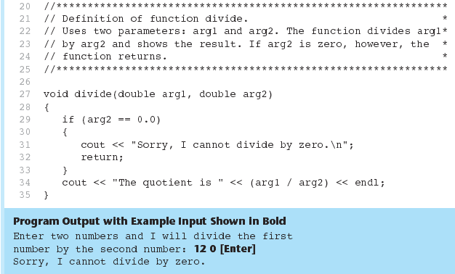
Example 2
PAGE 39

Slide 40
Returning a Boolean Value
Function can return true or false
Declare return type in function prototype and heading as bool
Function body must contain return statement(s) that return true or false
Calling function can use return value in a relational expression
PAGE 40

Slide 41
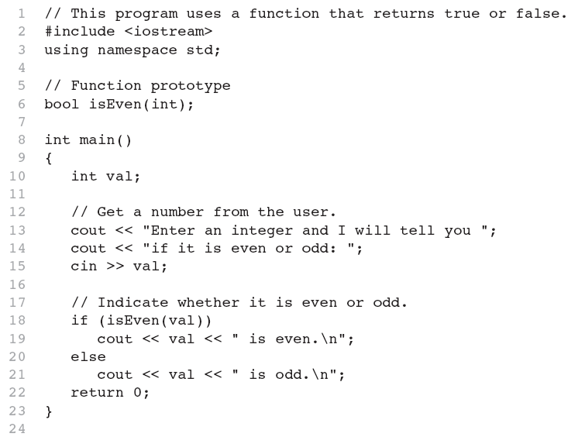
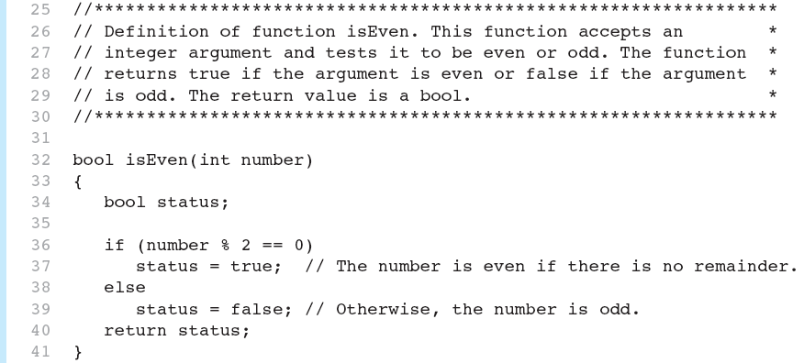

Example 3
PAGE 41

Slide 42
More info
[1] cplusplus.com: Functions
https://cplusplus.com/doc/tutorial/functions/
[2] learncpp.com: 2.2 – Function return values
https://www.learncpp.com/cpp-tutorial/function-return- values/
PAGE 42

Slide 43
Local & Global Variables
ELEC1006: ENGINEERING COMPUTING

Slide 44
Local Variables
Variables defined inside a function are local to that function. They are hidden from the statements in other functions, which normally cannot access them.
Because the variables defined in a function are hidden, other functions may have separate, distinct variables with the same name.
PAGE 44

Slide 45
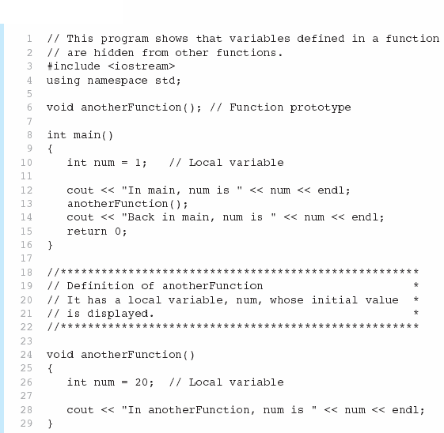

Example 1
PAGE 45

Slide 46
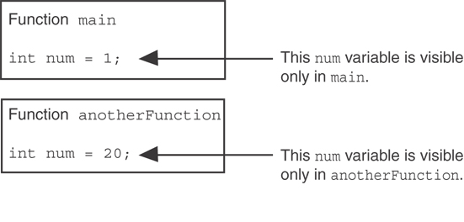
Example 1 continued …
When the program is executing in main, the num variable defined in main is visible only in main.
The num variable in anotherFunction is visible only in anotherFunction and is separate from the num used in main.
PAGE 46

Slide 47
Lifetime of a Local Variable
A function’s local variables exist only while the function is executing. This is known as the lifetime of a local variable.
When the function begins, its local variables and its parameter variables are created in memory, and when the function ends, the local variables and parameter variables are destroyed.
This means that any value stored in a local variable in a called function is lost when the called function ends and execution returns to the calling function.
PAGE 47

Slide 48
Global Variables & Global Constants
A global variable is any variable defined outside all the functions in a program.
The scope of a global variable is the portion of the program from the global variable definition to the end of the source code.
This means that a global variable can be accessed by all functions that are defined after the global variable is defined.
PAGE 48

Slide 49
Warning on using Global Variables
You should avoid using global variables because they make programs difficult to debug.
Any global that you create should be global constants.
PAGE 49

Slide 50
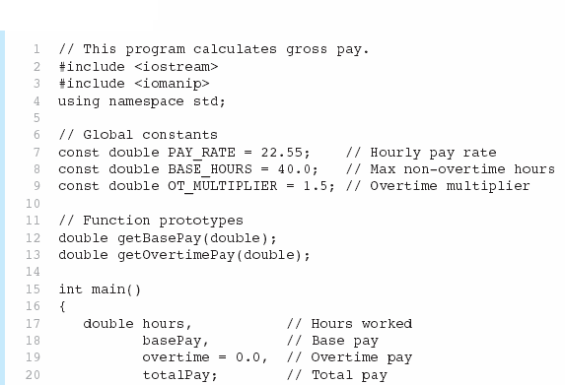
Example 2
Global constants defined for values that do not change throughout the program’s execution.
PAGE 50

Slide 51



Example 2 continued …
The constants are then used for those values throughout the program.
PAGE 51

Slide 52
Initialising Local & Global Variables
Local variables are not automatically initialized. They must be initialized by programmer.
Global variables (not constants) are automatically initialized to 0 (numeric) or NULL (character) when the variable is defined.
PAGE 52

Slide 53
More info
[1] cplusplus.com: Variables. Data Types.
https://www.cplusplus.com/doc/oldtutorial/variables/
[2] learncpp.com: 6.3 – Local variables
https://www.learncpp.com/cpp-tutorial/local-variables/
[3] learncpp.com: 6.4 – Introduction to global variables
https://www.learncpp.com/cpp-tutorial/introduction-to- global-variables/
PAGE 53

Slide 54
Static Local Variables & Default Arguments
ELEC1006: ENGINEERING COMPUTING

Slide 55
Static Local Variables
Local variables only exist while the function is executing. When the function terminates, the contents of local variables are lost.
static local variables retain their contents between function calls.
static local variables are defined and initialized only the first time the function is executed. 0 is the default initialization value.
PAGE 55

Slide 56
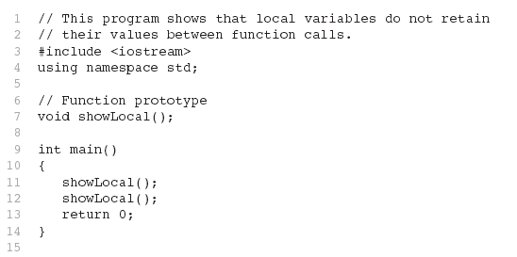
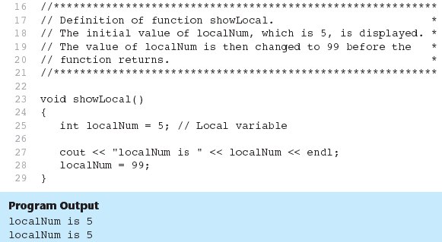
Example 1: Local Variables
In this program, each time showLocal is called, the localNum variable is re-created and initialized with the value 5.
PAGE 56

Slide 57
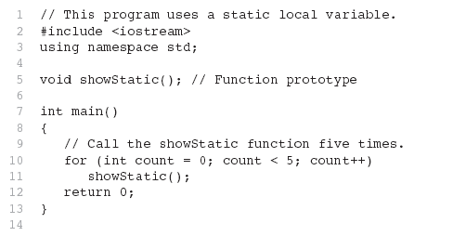
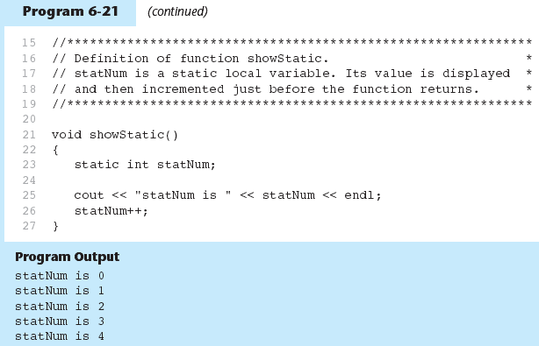
Example 2: Static Local Variables
statNum is automatically initialized to 0. Notice that it retains its value between function calls.
PAGE 57

Slide 58
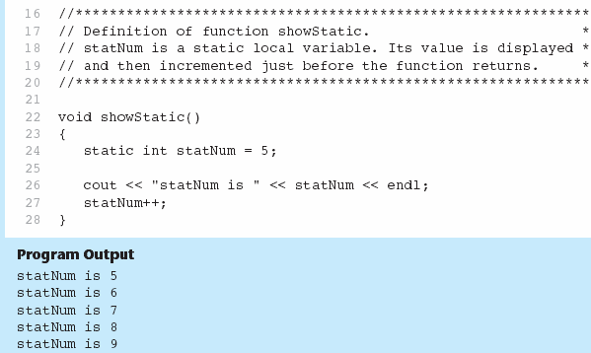
If you initialize a local static variable, the initialization only happens once.
The lifetime of a static variable is from the moment it is invoked till the end of the program.
PAGE 58

Slide 59
Default Arguments
A Default argument is an argument that is passed automatically to a parameter if the argument is missing on the function call.
Must be a constant declared in prototype:
void evenOrOdd(int = 0);
Can be declared in header if no prototype
Multi-parameter functions may have default arguments for some or all of them:
int getSum(int, int=0, int=0);
PAGE 59

Slide 60
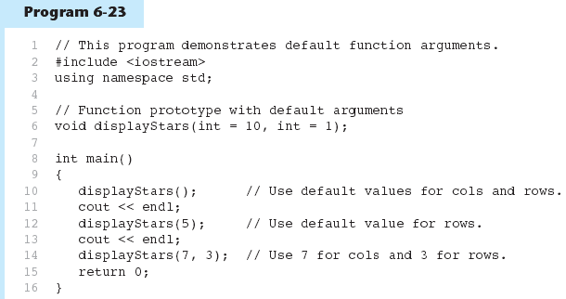
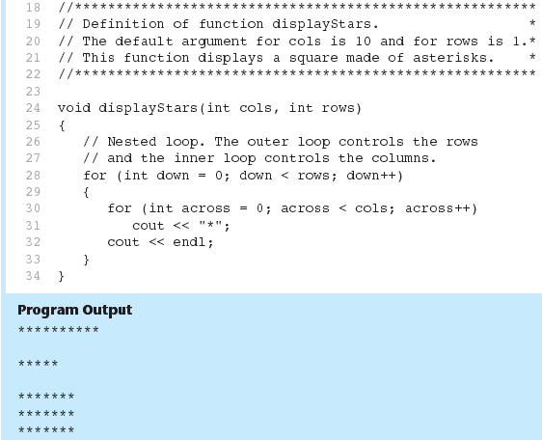
Example 3: Default Arguments
Default arguments specified in the prototype
PAGE 60

Slide 61
Default Arguments
If not all parameters to a function have default values, the default less ones are declared first in the parameter list:
int getSum(int, int=0, int=0);// OK
int getSum(int, int=0, int); // NO
When an argument is omitted from a function call, all arguments after it must also be omitted:
sum = getSum(num1, num2); // OK
sum = getSum(num1, , num3); // NO
PAGE 61

Slide 62
More info
[1] cplusplus.com: Variables. Data Types.
https://www.cplusplus.com/doc/oldtutorial/variables/
[2] learncpp.com: 6.10 – Static local variables
https://www.learncpp.com/cpp-tutorial/static-local- variables/
[3] learncpp.com: 7.7 – Default arguments
https://www.learncpp.com/cpp-tutorial/77-default- arguments/
PAGE 62

Slide 63
Reference Variables & Function Overloading
ELEC1006: ENGINEERING COMPUTING

Slide 64
Reference Variable
A mechanism that allows a function to work with the original argument from the function call, not a copy of the argument.
Allows the function to modify values stored in the calling environment.
Provides a way for the function to ‘return’ more than one value.
PAGE 64

Slide 65
Passing by Reference
A reference variable is an alias for another variable.
Defined with an ampersand (&)
void getDimensions(int&, int&);
Changes to a reference variable are made to the variable it refers to.
Use reference variables to implement passing parameters by reference.
PAGE 65

Slide 66
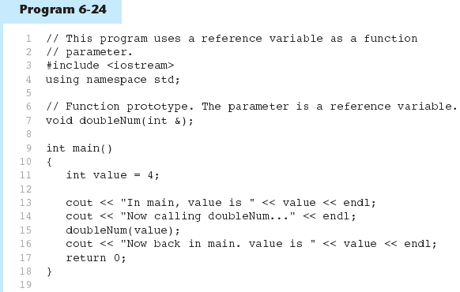
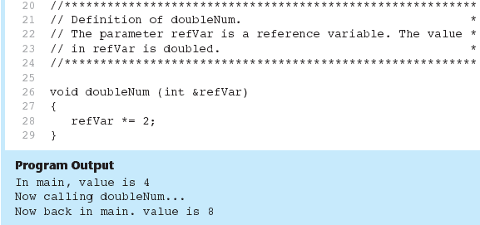
Example 1
The & here in the prototype indicates that the parameter is a reference variable.
Here we are passing value by reference.
The & also appears here in the function header.
PAGE 66

Slide 67
Reference Variable Notes
Each reference parameter must contain &.
Space between type and & is unimportant.
Must use & in both prototype and header.
Argument passed to reference parameter must be a variable – cannot be an expression or constant.
Use when appropriate – don’t use when an argument should not be changed by a function, or if a function needs to return only 1 value.
PAGE 67

Slide 68
Overloading Functions
Overloaded functions have the same name but different parameter lists.
Can be used to create functions that perform the same task but take different parameter types or different number of parameters.
Compiler will determine which version of function to call by argument and parameter lists to pass to the function.
PAGE 68

Slide 69
Function Overloading Examples
Using these overloaded functions,
void getDimensions(int); // 1
void getDimensions(int, int); // 2
void getDimensions(int, double); // 3
void getDimensions(double, double);// 4
the compiler will use them as follows:
int length, width;
double base, height;
getDimensions(length); // 1
getDimensions(length, width); // 2
getDimensions(length, height); // 3
getDimensions(height, base); // 4
PAGE 69

Slide 70
More info
[1] cplusplus.com: Variables and types.
https://www.cplusplus.com/doc/tutorial/variables/
[2] cplusplus.com: Overloads and templates
https://www.cplusplus.com/doc/tutorial/functions2/
[3] learncpp.com: 6.11 – Reference variables
https://www.learncpp.com/cpp-tutorial/611- references/comment-page-1/
[4] learncpp.com: 7.6 – Function overloading
https://www.learncpp.com/cpp-tutorial/76-function- overloading/
PAGE 70

